Slide 1

DEVOPS & DEVSECOPS CAPSTONE PROJECT
MinePulse
From Application Code to Automated Kubernetes Deployment
Automating application delivery with CI/CD, Docker, Kubernetes, Helm and Argo CD.
Manthan Kalra · Roll No. 24bcs10478 · Batch A
Notes:
Introduce the TaskBoard capstone project: taking raw application source through automated verification, packaging, and GitOps-driven deployment into Kubernetes.

Slide 2
PROJECT FOUNDATION
Delivery is more than writing the application
THE ENGINEERING CHALLENGE
Operational Friction in Manual Delivery
Eliminating manual interventions, configuration drift between environments, untracked artifact builds, and late-discovered vulnerabilities through declarative code.
MinePulse is a full-stack task and release management application. While CRUD functionality completes the software contract, production delivery also requires reliable packaging, policy checks, orchestration manifests, and runtime verification.
A developer commit must survive rigorous packaging, policy enforcement, orchestration manifests, and automated runtime reconciliation before it is fit for users.
CORE PROJECT PILLARS
Automation & Tests
Portability & Images
Continuous testing and security validation wired to every commit via GitHub Actions.
Isolated multi-stage container builds published to GHCR with deterministic commit SHAs.
Declarative Charts
GitOps Alignment
Helm packaging to structure deployments, services, namespaces, and PVC manifests.
Continuous state synchronization and automated drift reconciliation using Argo CD.
MinePulse Capstone Architecture Review · System Objectives
02
Notes:
Frame the problem: code functionality is only half the battle. Emphasize automation, repeatability, traceability, and consistency across both frontend and backend delivery.

Slide 3
ARCHITECTURE TOPOLOGY
Two flows: request path and delivery path
RUNTIME · REQUEST FLOW
DELIVERY · TWO DISTINCT CLUSTERS
From browser to database
CI workflow
User/browser → React frontend on Nginx → /api reverse proxy → FastAPI backend → PostgreSQL
Developer → GitHub repository → GitHub Actions → tests and security checks → Docker builds → GHCR → Helm → workflow's temporary Kind cluster
Alembic migrations · Frontend and backend separately containerized
GitOps path
GitHub repository + Helm chart → Argo CD → local Kind cluster
GitHub Actions never deploys into the local cluster.
03
Notes:
Clarify the strict separation: GitHub Actions validates and deploys to its workflow's temporary Kind cluster; Argo CD reconciles Git state in the distinct local Kind cluster.

Slide 4
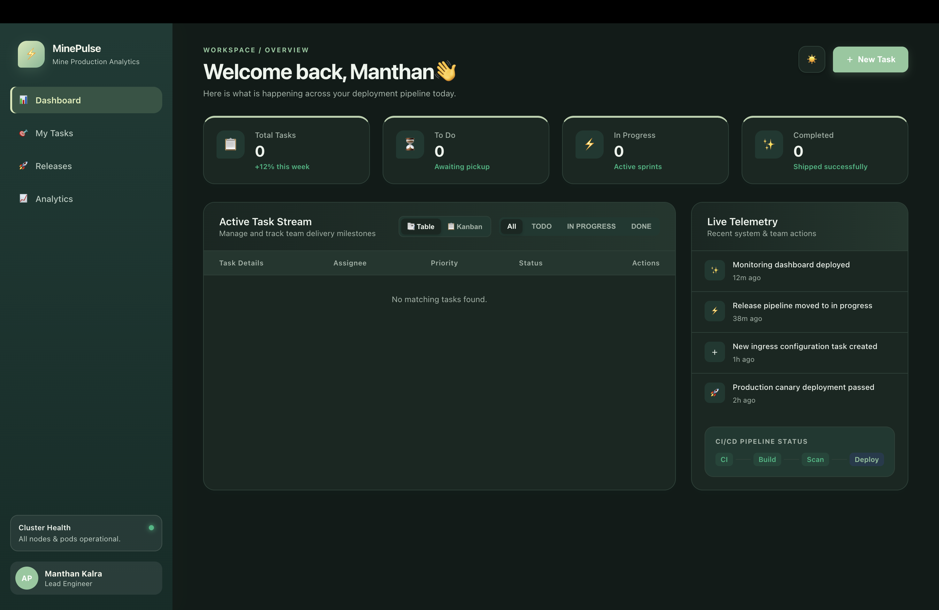
SYSTEM COMPOSITION
A layered stack, each tool with one job
BACKEND
DELIVERY
FRONTEND
Python · FastAPI
Build · Deploy · Operate
React UI · Vite · Nginx
FastAPI REST API with Pydantic-style schemas where implemented; SQLAlchemy with PostgreSQL; Alembic migrations; Pytest API tests.
Docker · GitHub Actions · GHCR · Kubernetes · Helm · Argo CD · Trivy · the workflow's configured security tools.
React UI and Vite asset builds; Nginx serves static files and proxies API requests.
SECONDARY VIEW
MinePulse application running through Kubernetes.
04
Notes:
Emphasize the distinct roles of the frontend, backend, and delivery tools.

Slide 5
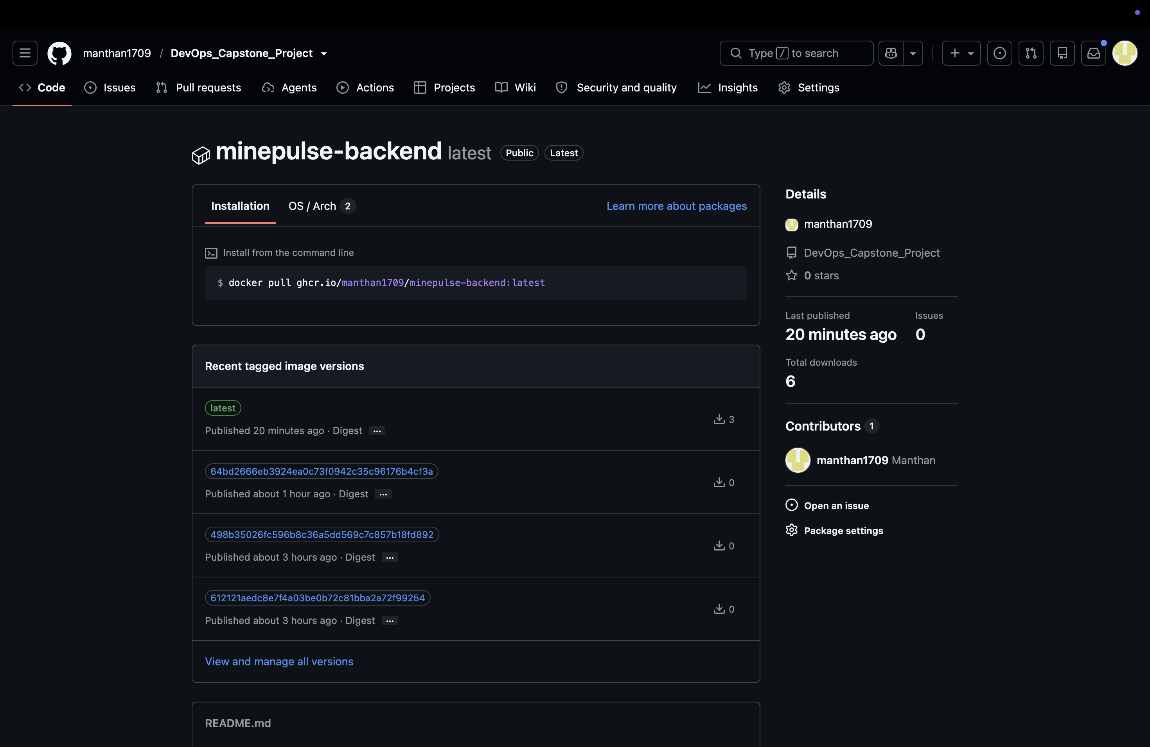

CONTAINER ARCHITECTURE
Containers make each component portable and traceable
Multi-stage Docker builds keep MinePulse images minimal and secure: compilers and package managers never ship into the production runtime.
FRONTEND · BUILD
FRONTEND · RUNTIME
BACKEND
Node.js build stage
Nginx serves the app
Separately built Python API
Installs dependencies with npm ci and runs Vite production compilation, generating optimized, minified static artifacts.
Nginx Alpine receives compiled static files and custom proxy configuration, serves the files, and proxies the API. Node runtime is excluded.
The Python slim image bundles FastAPI, dependencies, Alembic scripts, and database drivers.
PUBLISH · IMMUTABLE GHCR TAGS
Images are published to GHCR tagged with the Git commit SHA (e.g. :sha-4b2a8f1), giving an unbroken audit trail from running Kubernetes pods back to the exact source commit.
Backend container image published to GHCR
Frontend container image published to GHCR
Sequence: source code → Docker build → tagged images → GHCR → Kubernetes deployment
05
OCI Packaging Standard · GitHub Container Registry
Notes:
Walk through the multi-stage build pattern: Node is discarded after building frontend assets; Nginx Alpine serves them; Python slim runs backend; GHCR uses commit SHA tags for absolute provenance.

Slide 6




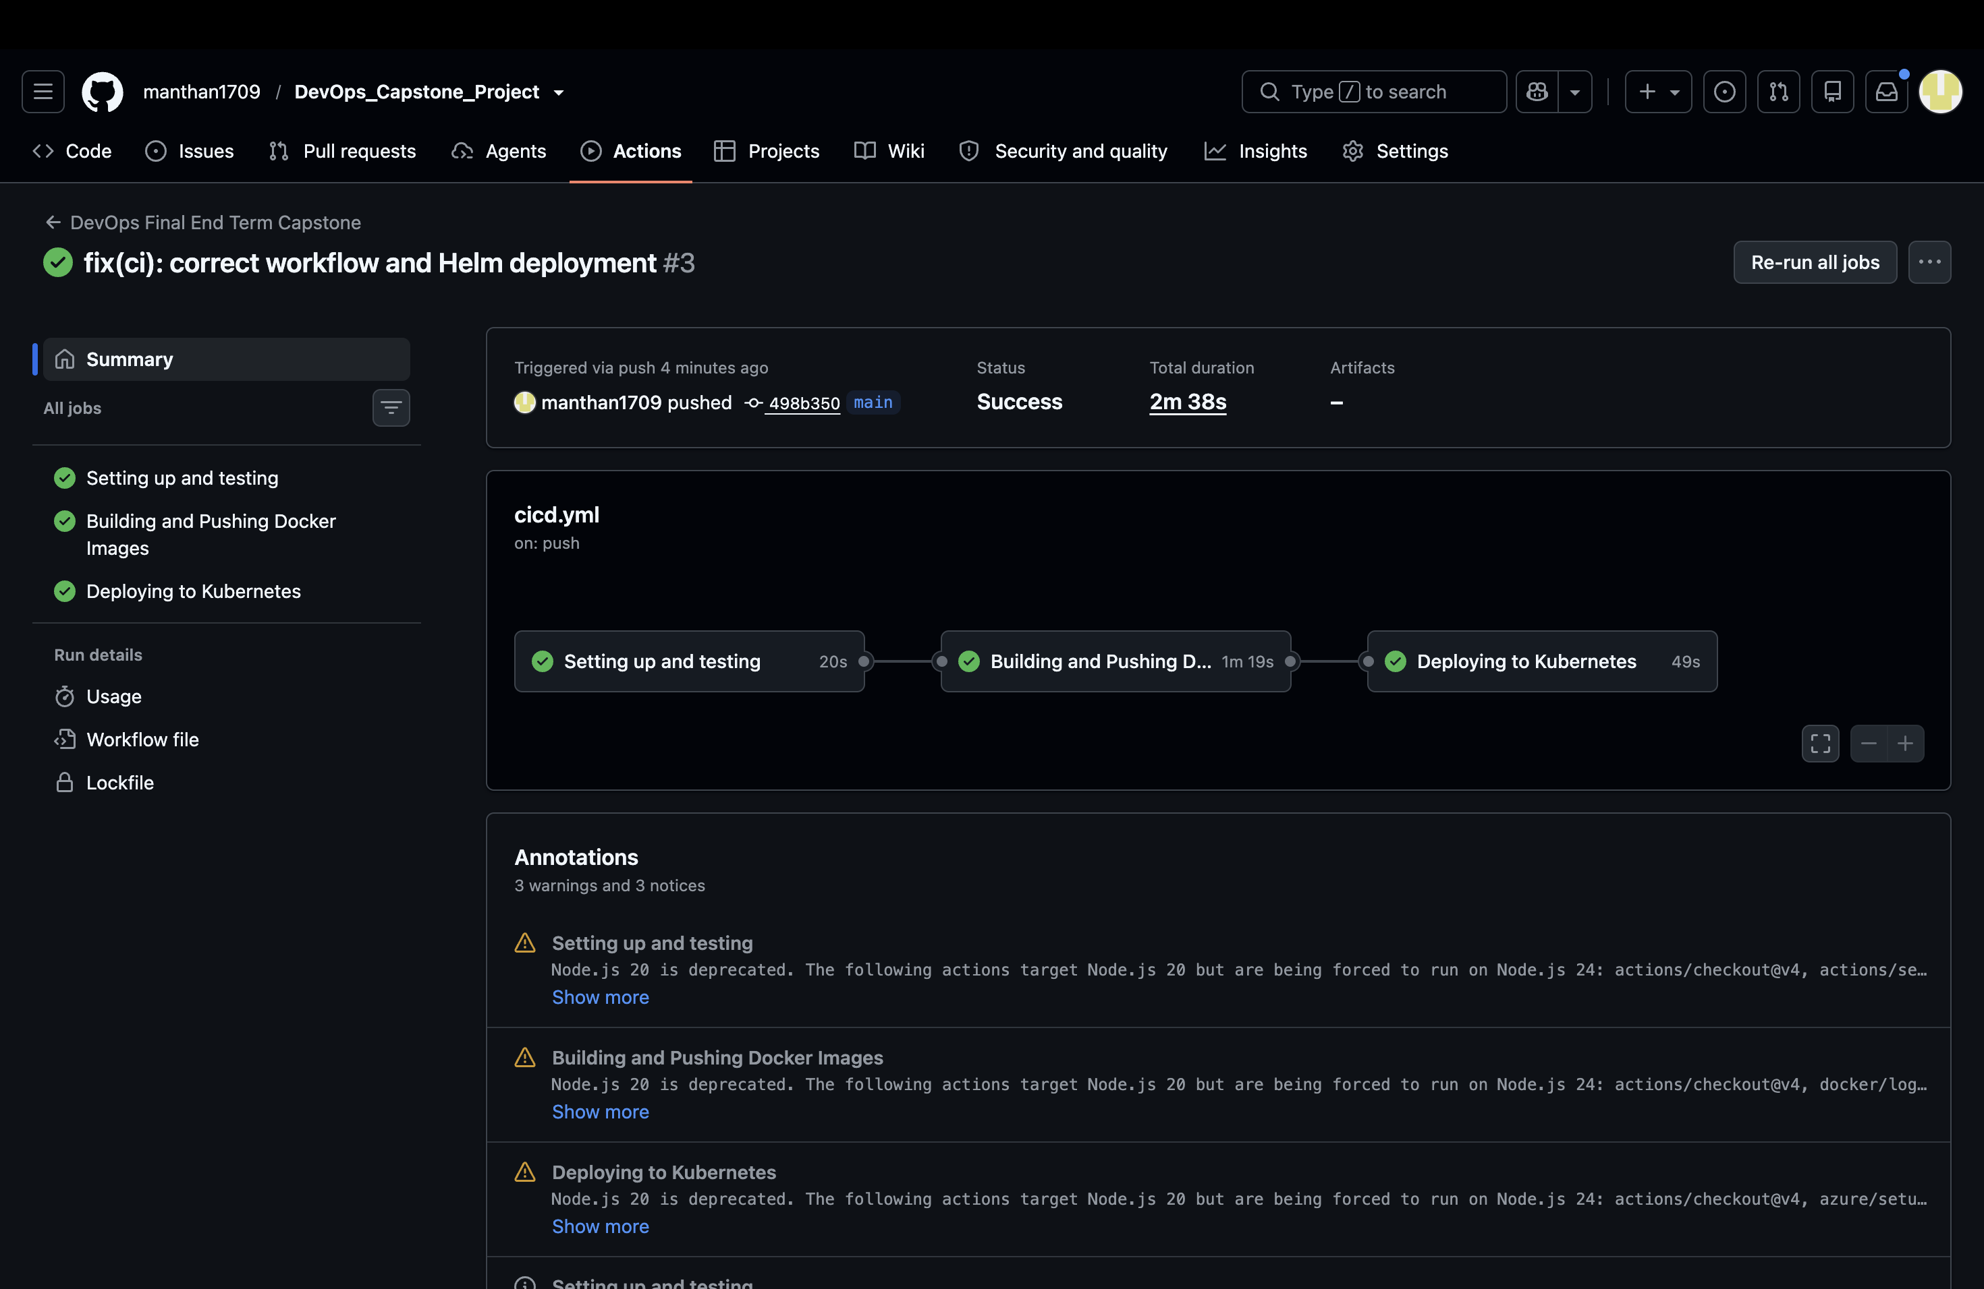
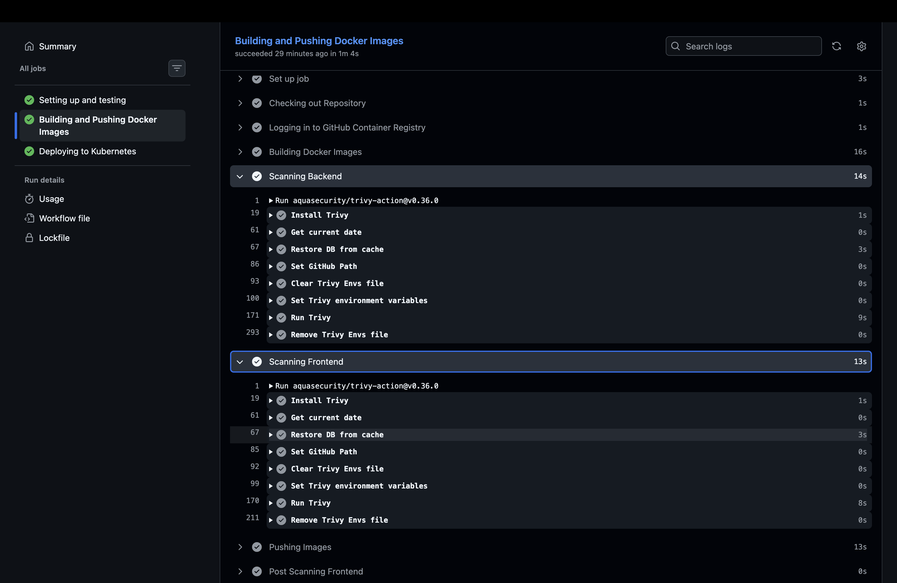
DEVSECOPS PIPELINE
Failed gates stop the pipeline before deployment
GitHub Actions runs tests and code validation, then applies configured security gates before image publication and Helm deployment to the workflow's temporary Kind environment.
CI checks
Security validation
Image publishing
Deployment
Push or workflow dispatch; tests and code validation.
CodeQL, dependency scanning, and secret scanning (as configured in the repository).
Frontend and backend builds; Trivy severity-based failure gate; push to GHCR.
Helm deploy into the workflow's temporary Kind environment.
Trivy — container image security scan
Strict Downstream Blocking
Failed quality or security gates block downstream stages where configured, catching problems before deployment.
GitHub Actions — latest workflow run
06
Notes:
Explain how DevSecOps principles are applied in practice: tests run first, security scans gate image creation, Trivy scans built images, and only clean builds proceed to ephemeral testing.

Slide 7
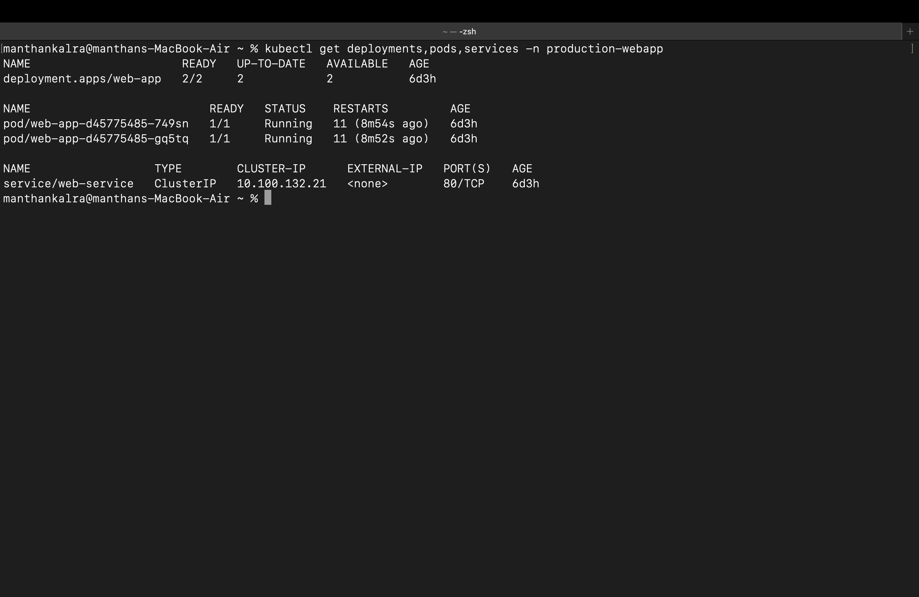
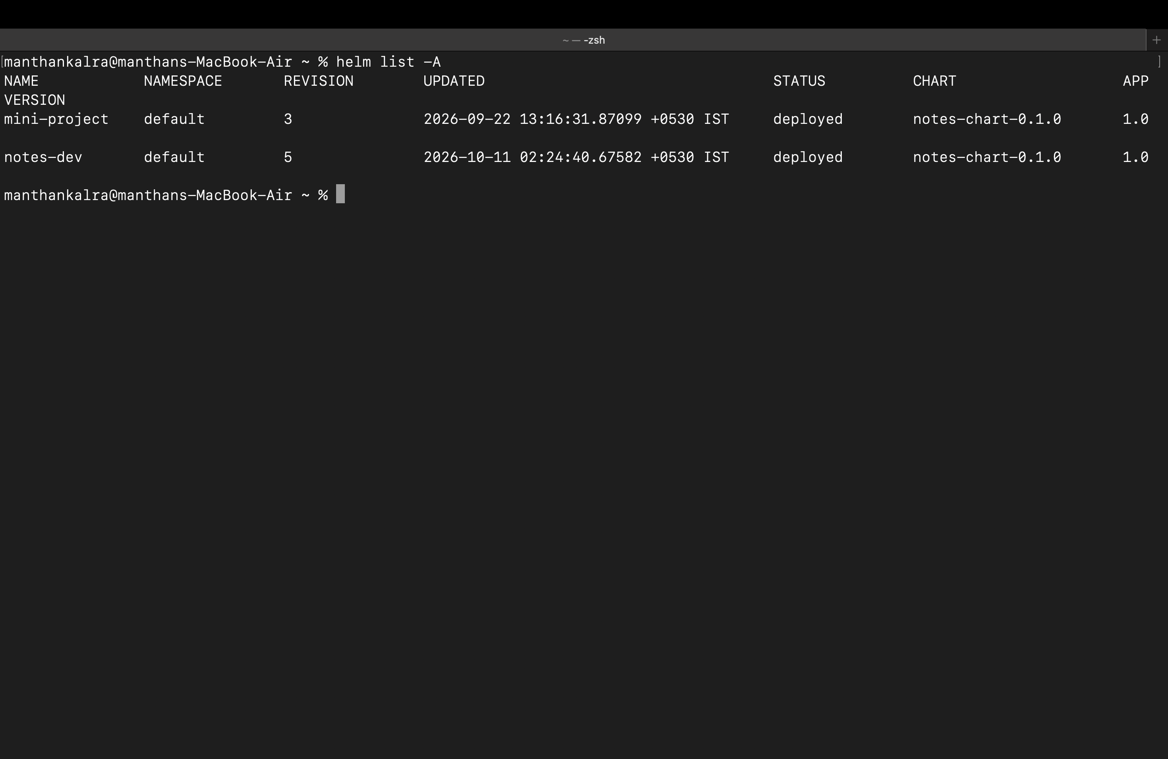
ORCHESTRATION ARCHITECTURE
Helm organizes MinePulse into Kubernetes resources
ACTIVE CHART WORKLOADS
HELM TEMPLATES & VALUES
Frontend Deployment & ClusterIP Service — Frontend Deployment and Pods; ClusterIP Service for internal networking and discovery.
Backend Deployment & ClusterIP Service — Backend Deployment and Pods; ClusterIP Service for internal networking and discovery.
PostgreSQL & PersistentVolumeClaim — PostgreSQL deployment with PersistentVolumeClaim storage where configured.
Image tags, replica settings, and health/readiness checks and resource settings only as present in the manifests.
OPTIONAL FEATURES (NOT CLAIMED AS ENABLED)
Ingress, Horizontal Pod Autoscaling, and Prometheus ServiceMonitor.
Kubernetes workloads, Services
Helm chart validation — no lint failures
07
Namespaces organize resources; PostgreSQL storage uses a PersistentVolumeClaim where configured.
Notes:
Detail the Kubernetes resources managed by the Helm chart. Clarify that optional chart configuration is not claimed as enabled: Ingress, Horizontal Pod Autoscaling, and Prometheus ServiceMonitor.

Slide 8
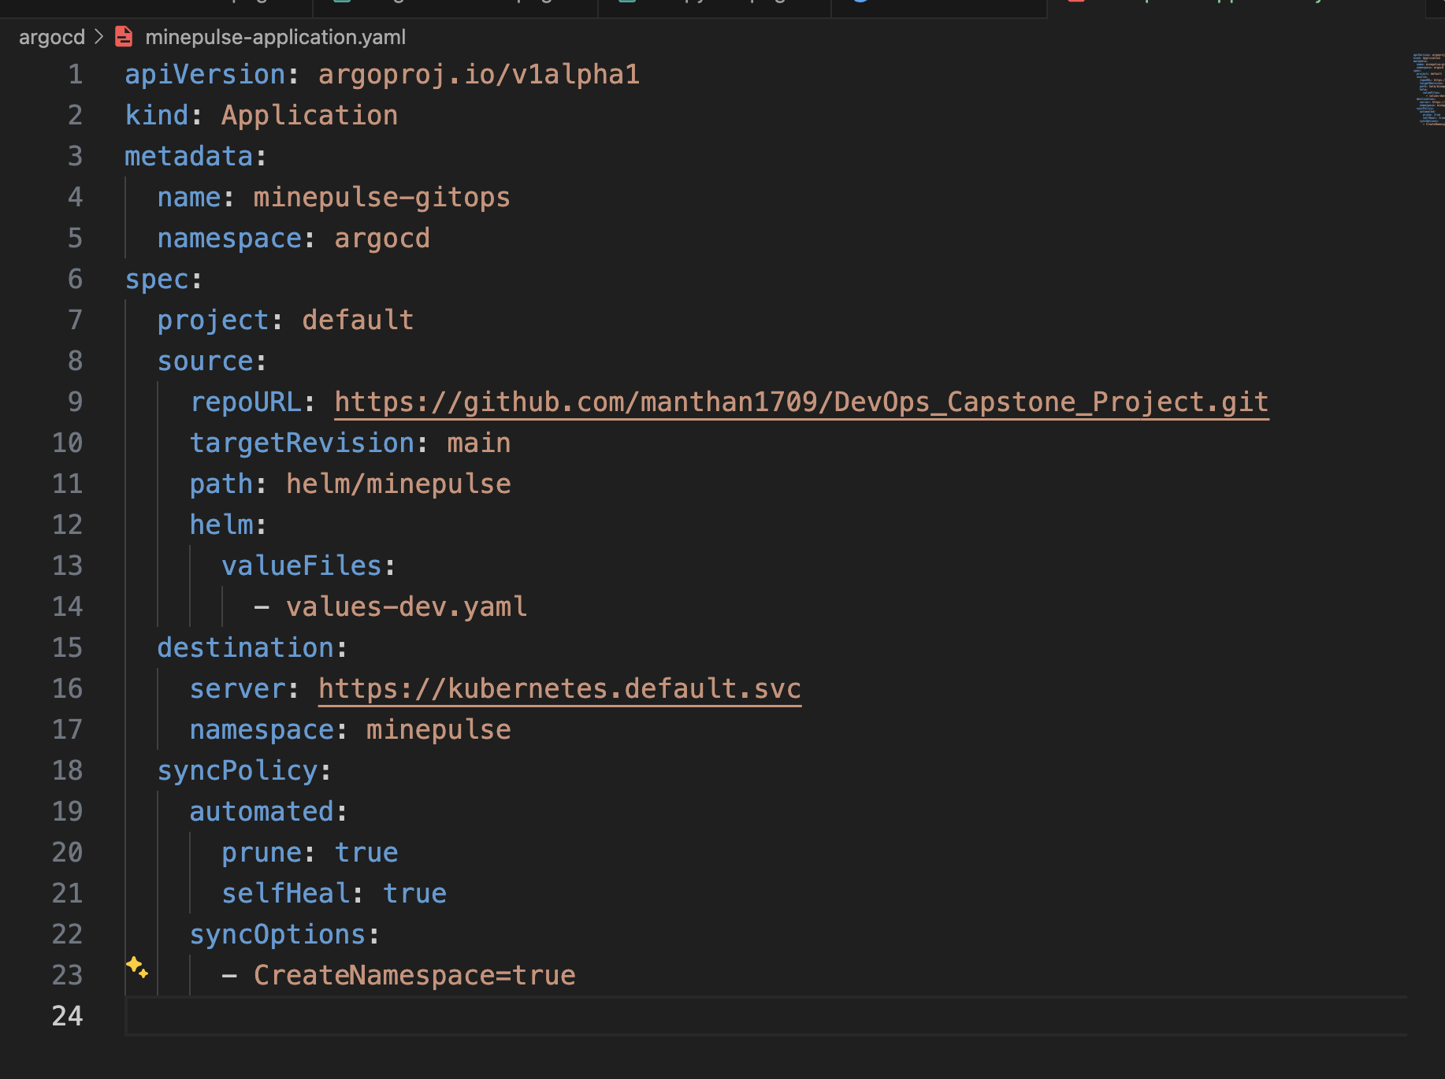
CONTINUOUS DEPLOYMENT
Git holds desired state; Argo CD reconciles it
GITOPS FLOW
Git repository → Helm chart → Argo CD Application → Kubernetes resources
Local demo
Kind cluster; Argo CD runs in its own argocd namespace. The minepulse-gitops Application targets helm/minepulse; resources go to a separate minepulse-gitops namespace.
Sync status compares Git with live state; health status reports resource condition. Declarative configuration improves repeatability.
Separate clusters
Argo CD
The Argo CD local Kind cluster is separate from the CI workflow's temporary Kind deployment.
08
Notes:
Explain the GitOps reconciliation: Git is the source of desired state, Argo CD compares it with the live cluster, and the Argo CD Kind cluster is separate from the CI workflow's temporary cluster.

Slide 9
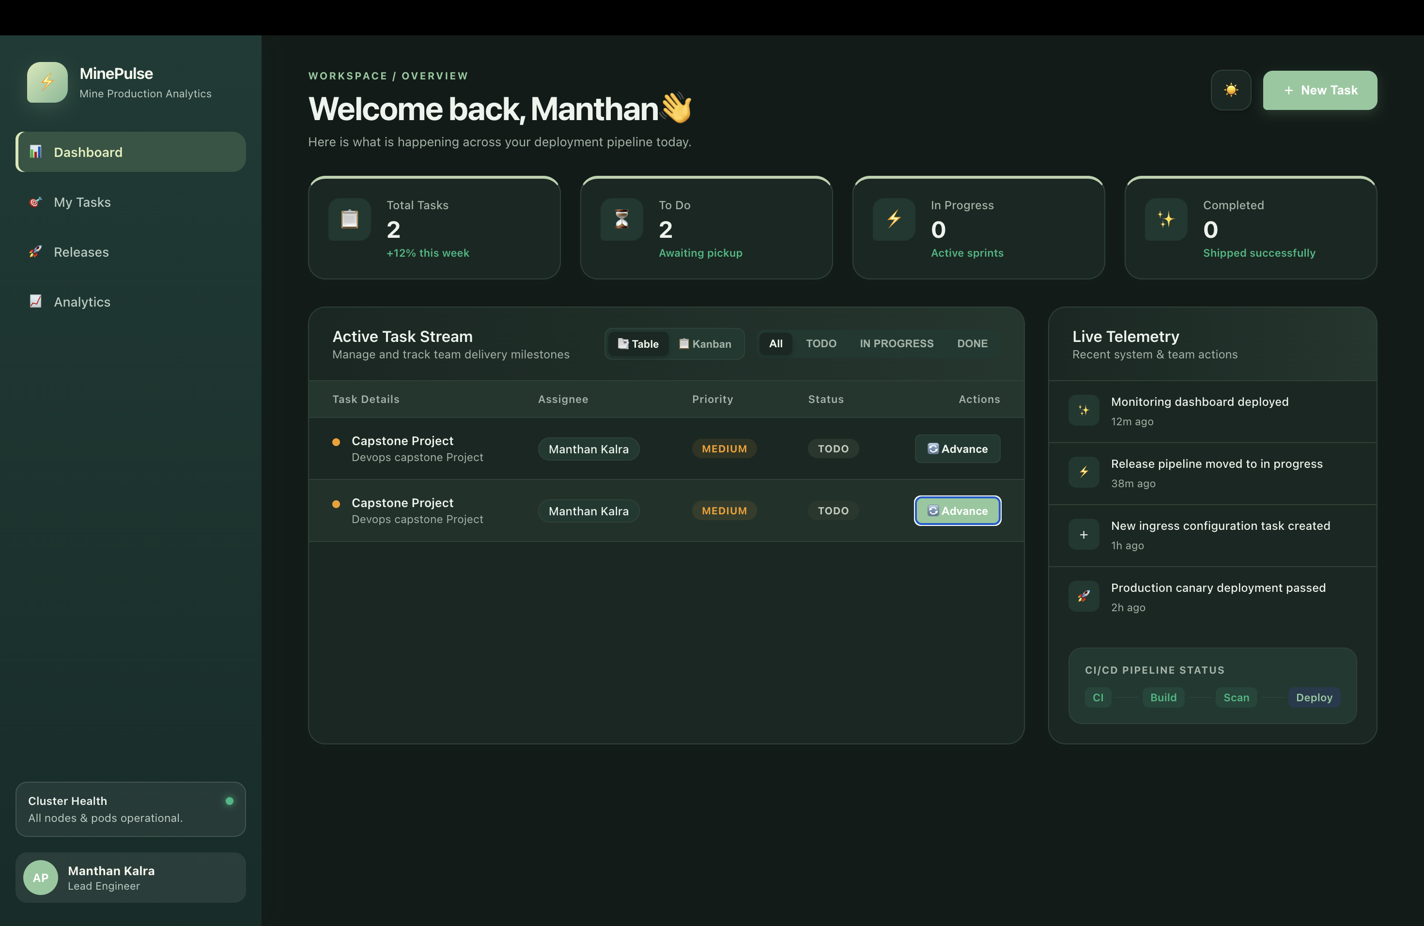
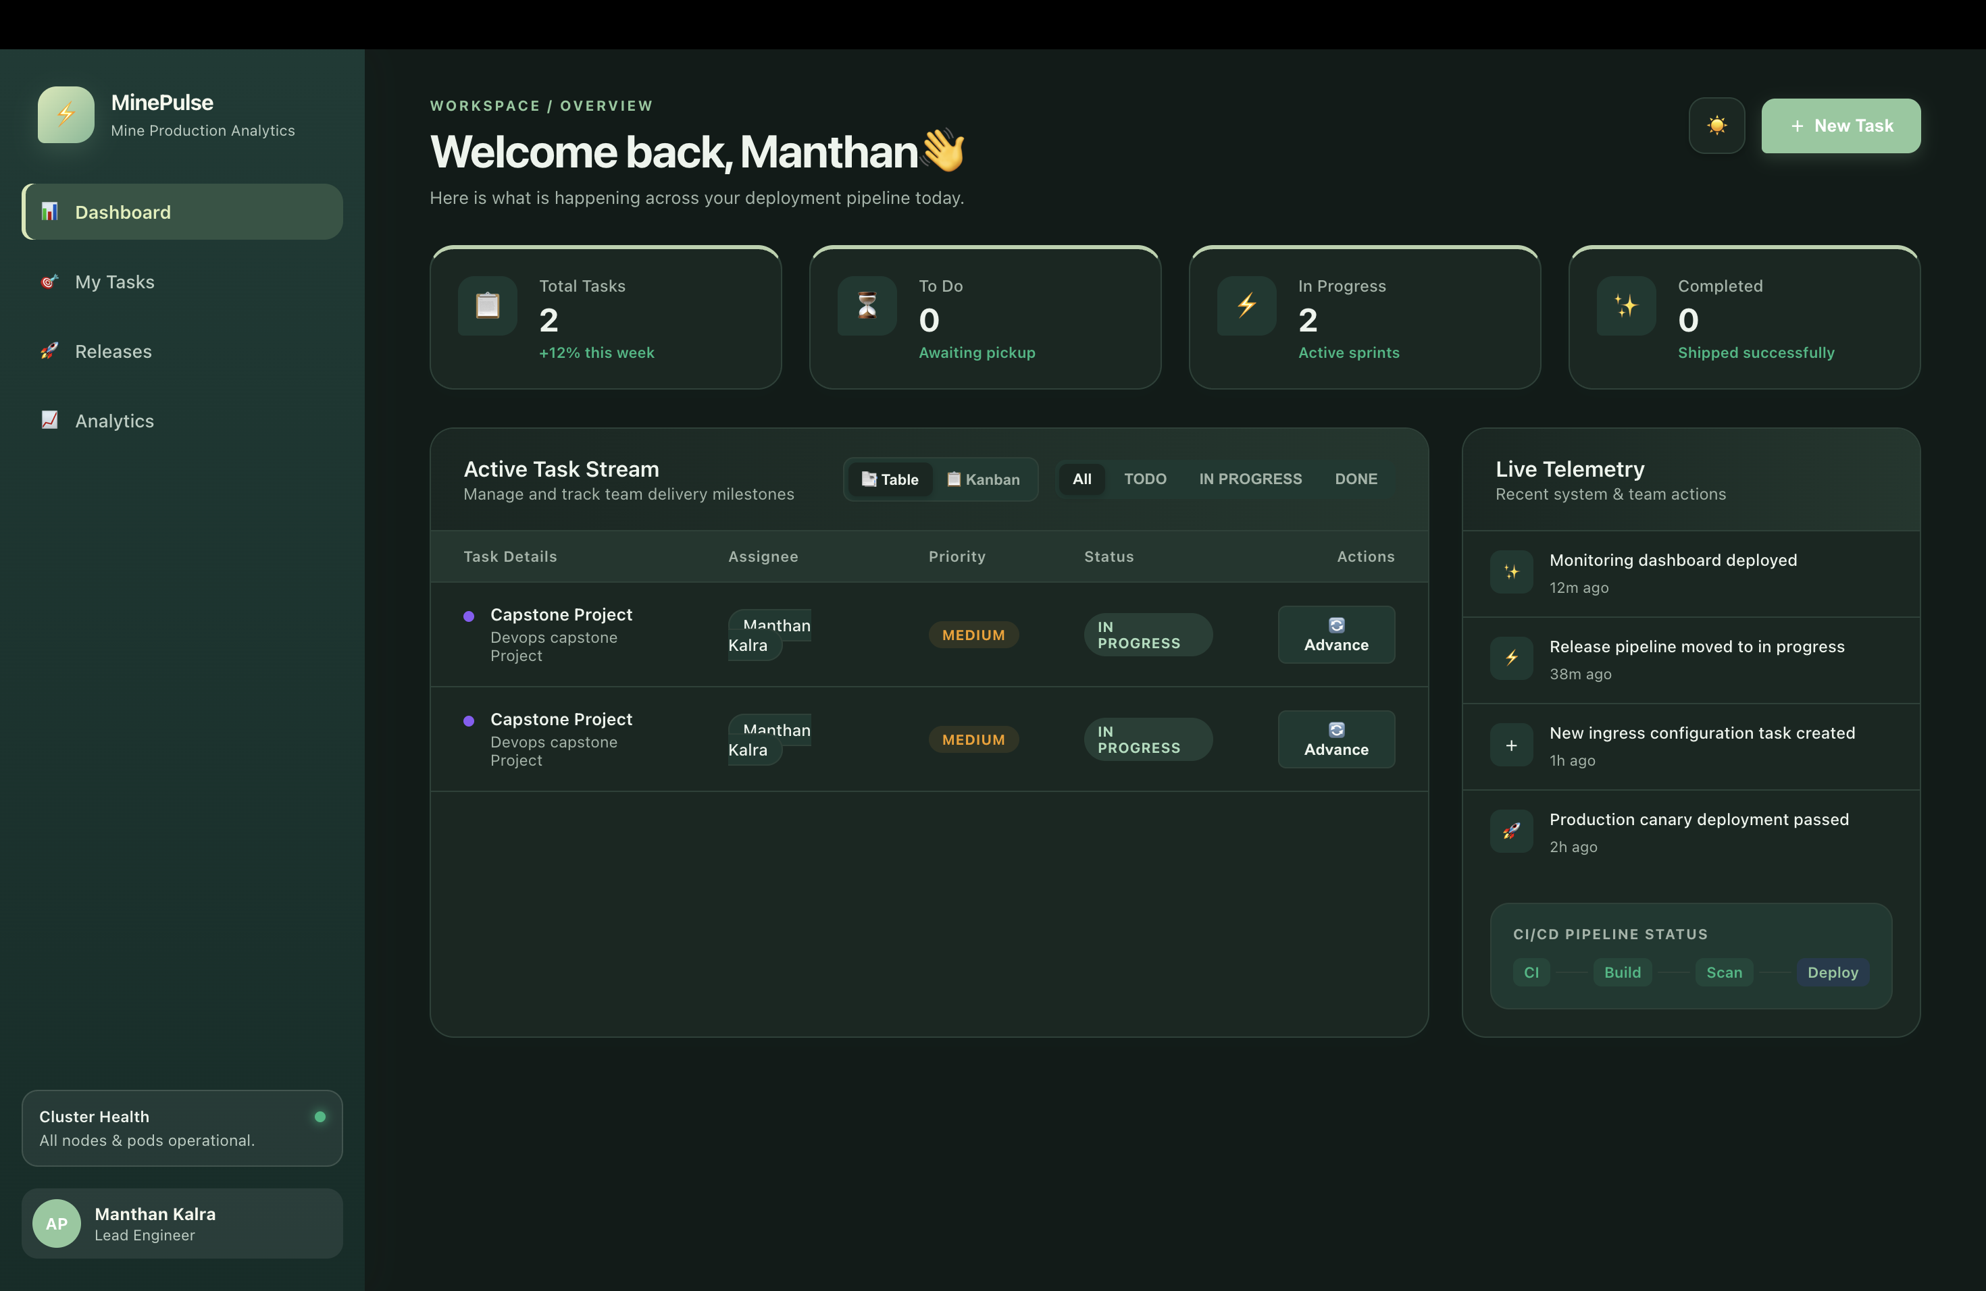
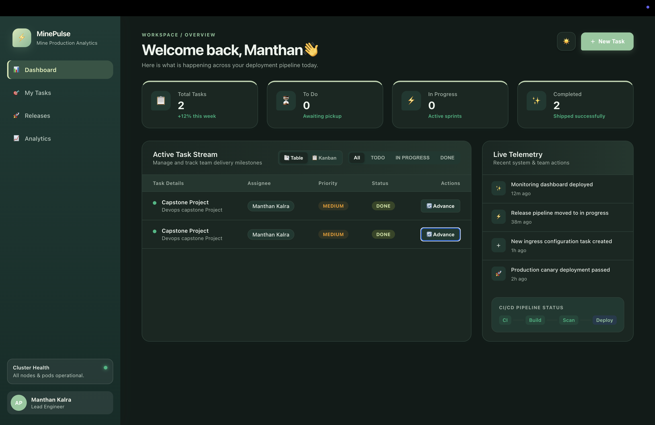
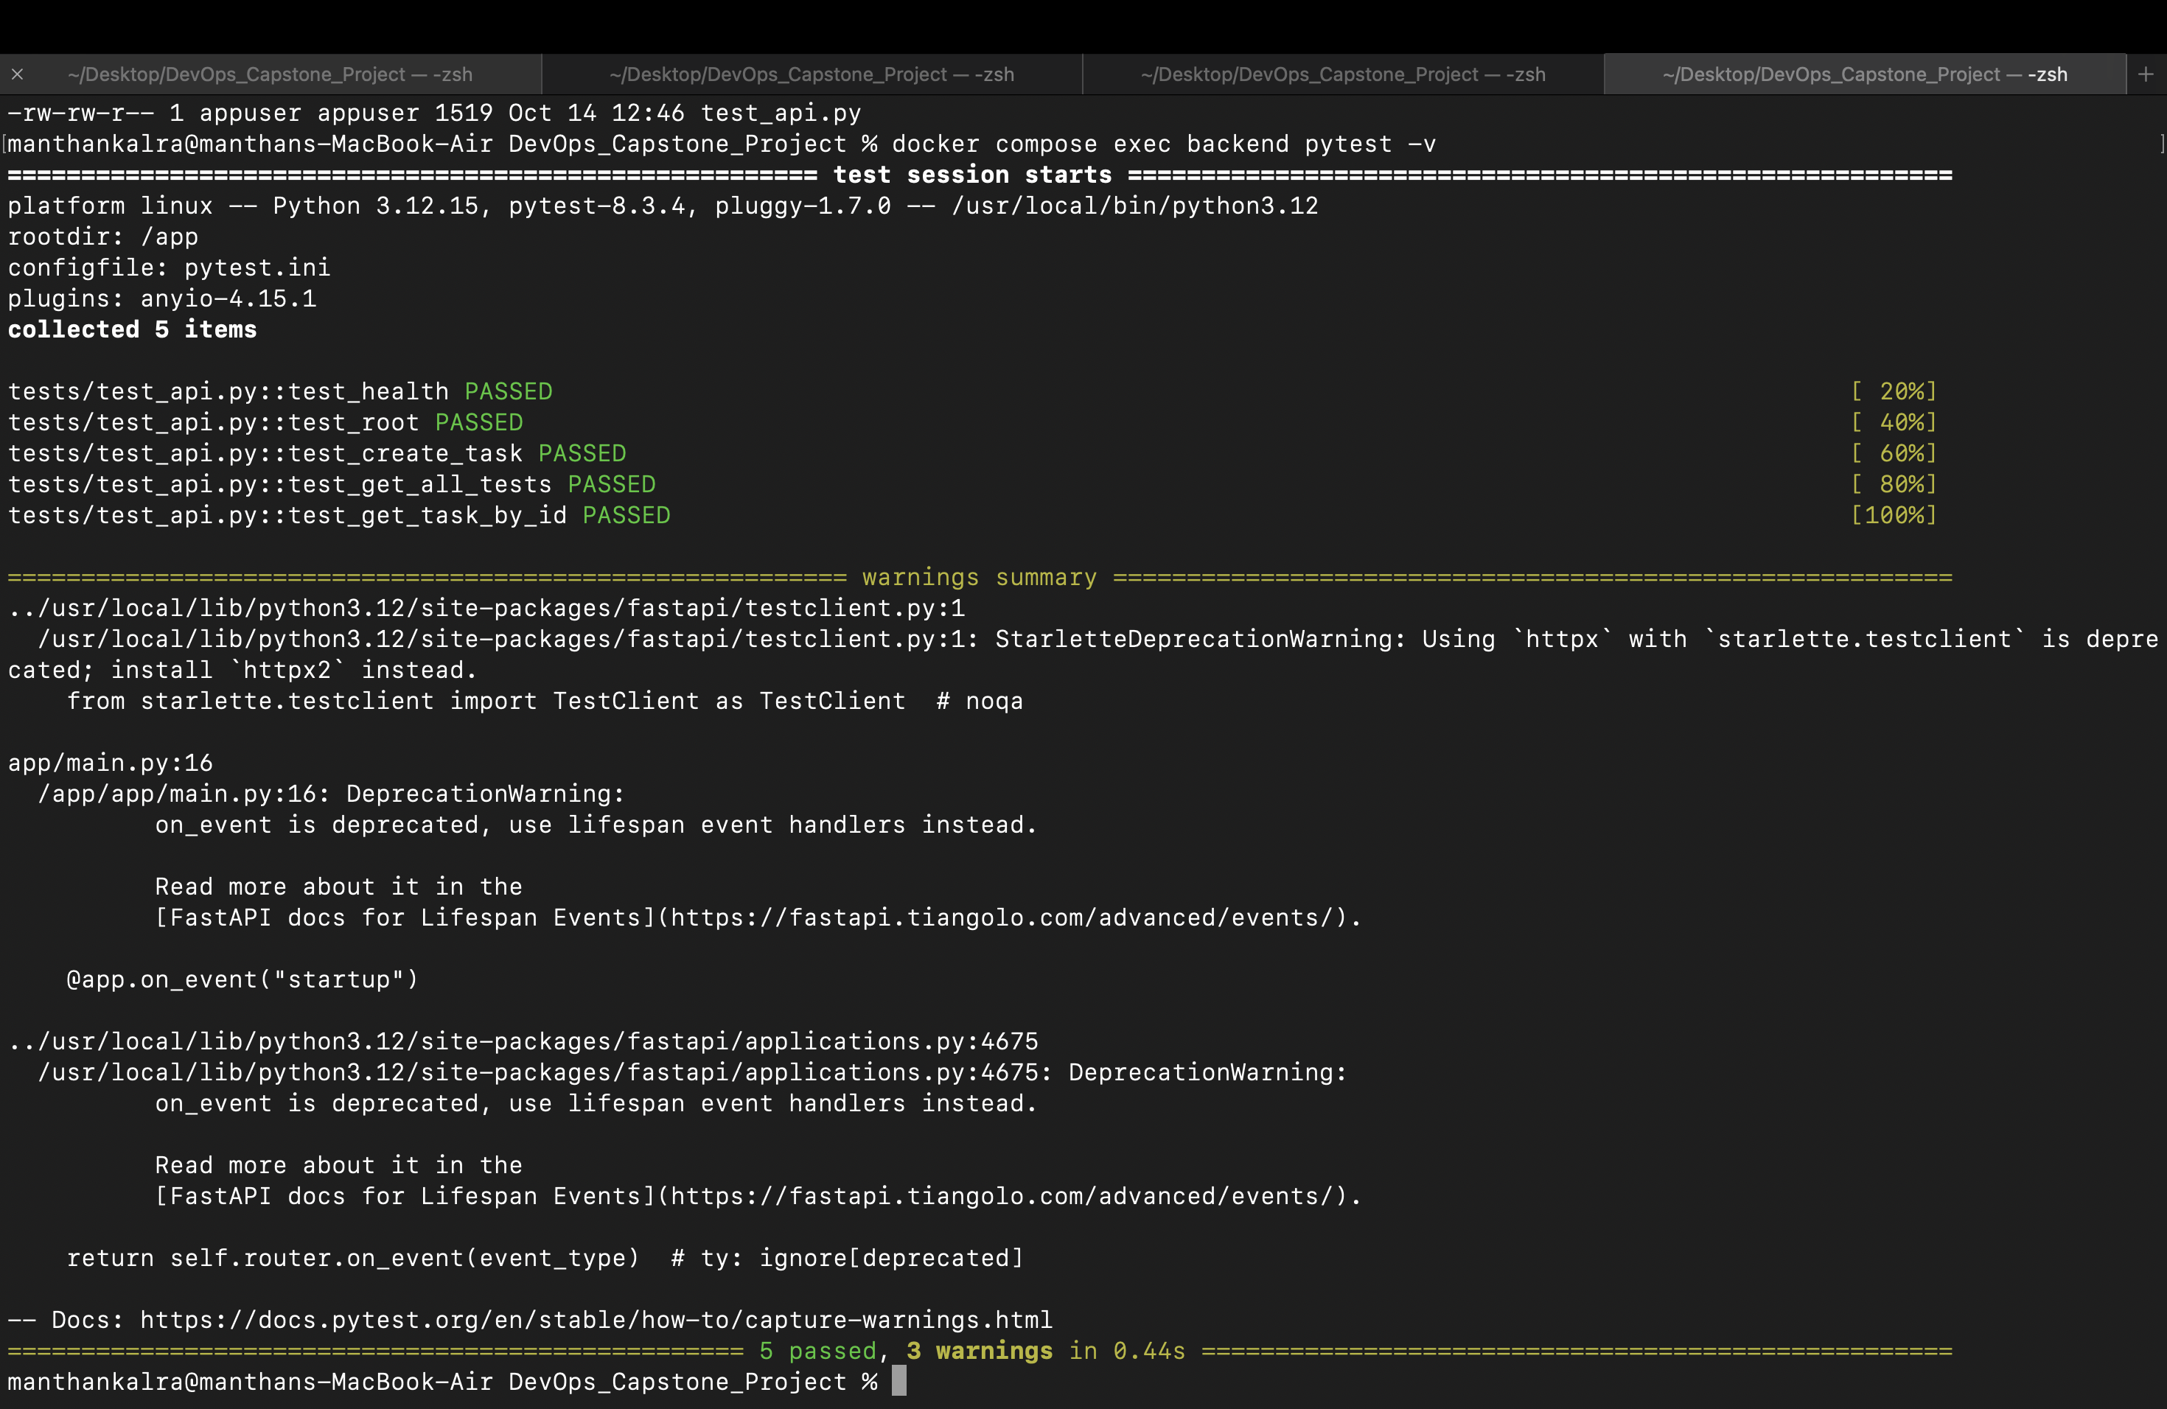
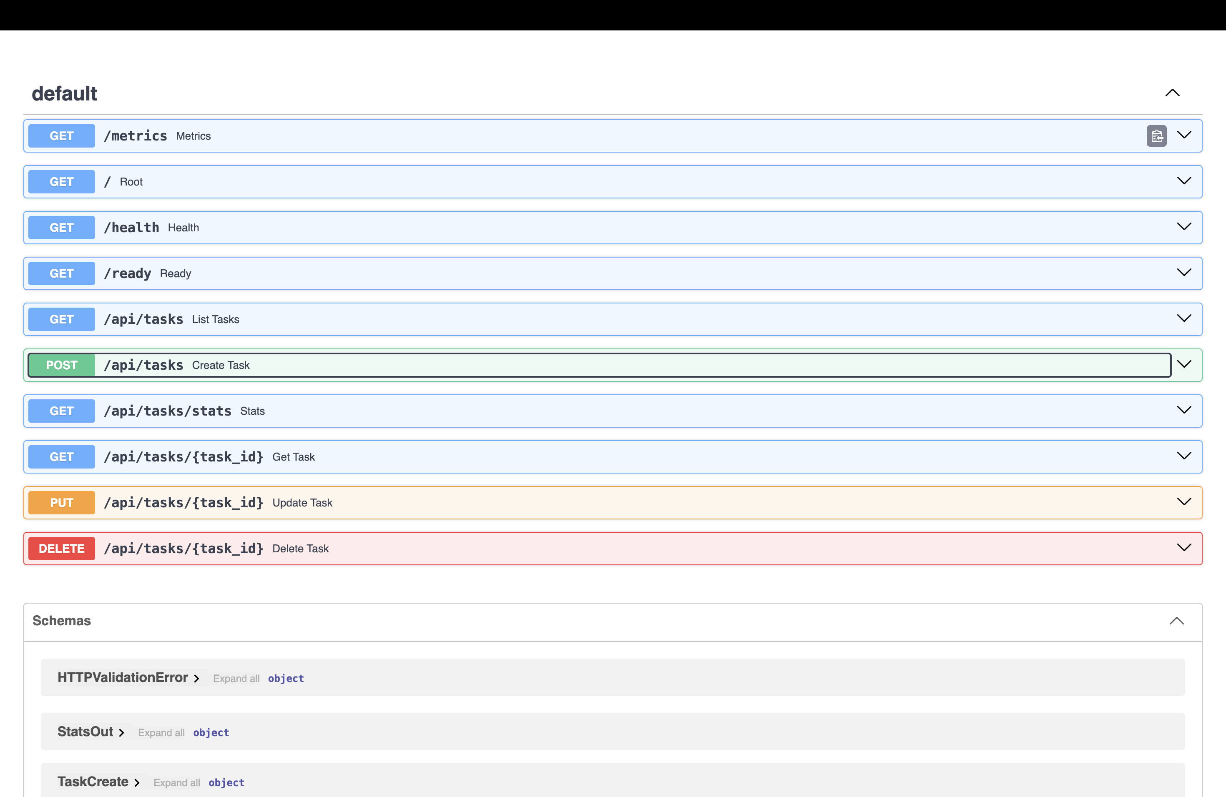
VERIFICATION MATRIX
Evidence: what each screenshot proves
Each required deliverable is mapped directly to concrete verification evidence confirming end-to-end operational readiness.
To Do
In Progress
Completed
Backend API tests
Kubernetes health and API verification
09
Evaluation Artifacts: Verified on local demonstration environment and GitHub repository logs.
Notes:
Present the evidence gallery clearly: the three task-board states show the To Do, In Progress and Completed frames; the pytest result and the API health check are shown in the lower row without fabricating log text or metrics.

Slide 10
RETROSPECTIVE & EVALUATION
PRODUCTION ROADMAPPING
Lessons, honest scope and next steps
Honest Current Scope
No AWS deployment is provisioned; any Terraform is infrastructure code only, not applied.
Ingress, autoscaling and Prometheus are optional unless verified.
Move credentials out of plaintext manifests into Kubernetes Secrets or similar; never show values.
Engineering Lessons Learned
Proxy hostnames: Align frontend proxy hostnames with Kubernetes Service names.
Helm naming: Understand Helm release names versus generated resource names.
Connectivity: Address intermittent DNS and repository connectivity.
Cluster separation: Keep CI's temporary cluster separate from the Argo CD deployment.
Next Production Milestones
Validated configuration reconciliation and stronger secret management.
Tested autoscaling.
Prometheus/Grafana dashboards and alerting.
Validation on hosted Kubernetes.
Conclusion: The project connects application development to automated quality and security checks, container image delivery, Kubernetes deployment and GitOps management.
10
Notes:
Close with an honest engineering evaluation: summarize technical hurdles solved during networking and templating, clearly delineate verified scope vs. future cloud extensions, and wrap up.

